Slide 1

Droimeann Cattle Society
How to pay for registration of Cattle

Slide 2
Droimeann Cattle Society Registration Fees (members only)
All animals on or before 2020 -15 euro
All animals born in 2021 – 25 euro
Females born in 2022 and onward – 50 euro
Males born in 2022 and onward – 75 euro
Herd Prefix - €40
ALL ANIMALS MUST BE PURITY TESTED PRIOR TO REGISTRATION !
All animals must be paid for in advance of receiving pedigree certificates.
Preferred method of payment is via the website.
Visa Debit/Cheque payments can be accommodated but may lead to a delay in receiving Certs due to manual process.
Please reach out to the following addresses so payments/registrations can be verified.
treasurer@droimeanncattlesociety.com (payment for registrations)
registrar@droimeanncattlesociety.com (registrations)
Best to copy both emails with your query

Slide 3
Droimeann Cattle Society Registration Fees (Breeders Non Members)
Registration of Male - €100
Registration of Female - €75
Herd Prefix - €80
ALL ANIMALS MUST BE PURITY TESTED PRIOR TO REGISTRATION !
All animals must be paid for in advance of receiving pedigree certificates.
Preferred method of payment is via Visa Debit/ Bank Transfer /Cheque
Please reach out to the following addresses so payments/registrations can be verified.
treasurer@droimeanncattlesociety.com (payment for registrations)
registrar@droimeanncattlesociety.com (registrations)
Best to copy both emails with your query

Slide 4
How to log on to Pay?
Navigate to Breeders Login – Droimeann Cattle Society
Enter user name and password you would have received upon registering as a member on the website. There is a facility for users to reset their own password if they cannot remember it. (Lost your Password function)
Once Logged in go to the “My Account” dropdown and select “Schedule of Fees - Registrations”
You will see the various options to pay. Please refer to the slide on registration Fees to select the correction option.

Slide 5
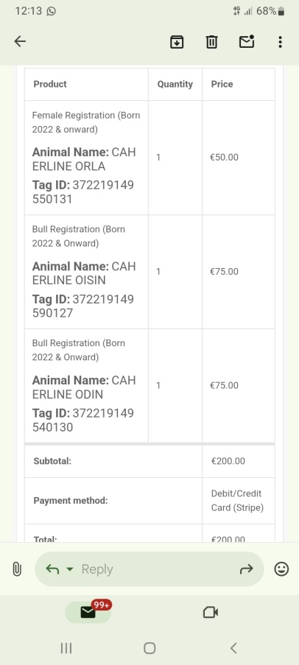
Registrations
Once you have selected the appropriate option for registration, use the following slide as an example on how to complete the entry fields.
Entry must only be filled out for 1 animal each time, no batch entries as we must allow for verification of each animal prior to registration.
Enter the animal tag ID and Animal name in the fields provided.
At this stage you can add to cart, if you have other animals to register, you can navigate back to the various registration options or alternatively you can proceed to checkout and pay for you registrations.
You will receive a copy of your order via email, additionally , the registrars & treasurer will be notified of the order and will begin the verification and registration process.

Slide 6
Animal Naming Conventions (Letter) by year
2018 | I
2019 | J
2020 | K
2021 | L
2022 | M
2023 | N
2024 | O
2025 | P

